Slide 1
Learning assessment for Dyslexic Children using Multimodal Deep Learning Techniques
21ZC81 - Project Work II
BY
JAYACHANDRU K
21MZ02 – M.E CSE
UNDER THE GUIDENCE OF
MS. R. THIRUMAHAL
ASSISTANT PROFESSOR(S.G)
DEPARTMENT OF COMPUTER SCIENCE AND ENGINEERING

Slide 2
Agenda
Aim and Objectives
Abstract
Multimodal Learning
Literature Survey
EEG Device (MUSE 2)
EEG data Preparation
Data Collection
Dataset Details
Statistical Analysis
Existing ML and ANN Models
Handwritten Dataset and details
Existing CNN model
Multimodal Fusion
Conclusion
Reference

Slide 3
Aim
The aim of this study is to employ deep learning models to assess dyslexic children's writing abilities, specifically in recognizing and writing Tamil characters.
Develop a comprehensive approach that combines handwritten data and brain EEG signals.
Objective
Develop a deep learning model to assess dyslexic children's visual processing and writing abilities.
Integrate brain EEG signals, compare with traditional methods, and analyze correlations for comprehensive understanding.
3

Slide 4
Abstract
Deep learning models can be employed to assess dyslexic children's writing abilities, specifically in recognizing and writing Tamil characters.
The traditional deep learning techniques may not provide accurate assessments of dyslexic children's writing skills, necessitating a multimodal deep learning approach.
The multimodal approach combines handwritten data and brain EEG signals to gain a comprehensive understanding of dyslexic children's cognitive and neurological processes.
Handwritten data analysis helps evaluate the visual processing and writing abilities of dyslexic children, including letter formation, spacing, and overall legibility.
Incorporating brain EEG signals allows for insights into the neural mechanisms involved in processing and motor activities related to writing, providing a more accurate prediction of dyslexic children's writing abilities.
4

Slide 5
Dyslexia
Dyslexia is a specific learning disorder characterized by difficulties in reading, spelling, and writing, and there is a need to improve its assessment process.
Early identification is crucial for dyslexic children, and using deep learning and multimodal techniques can help identify the disorder at an early stage, enabling timely interventions.
Traditional assessment methods for dyslexia often rely on subjective evaluations, but incorporating deep learning models provides an objective approach, ensuring accurate measurements of writing abilities.
5

Slide 6
Multimodal Learning
Multimodal learning combines multiple sources of information, such as text, images, audio, and video, to enhance learning and improve performance.
It improves performance and robustness.
Feature fusion and alignment are key challenges in multimodal learning.
Multimodal learning finds applications in diverse domains, including computer vision, natural language processing, speech recognition, and human-computer interaction, benefiting tasks such as image classification, sentiment analysis, and more.

Slide 7

Types of Multimodal Fusion
Late Fusion
Early Fusion
Joint Fusion
Classifier
Classifier
Classifier
Pooling
Concat
CSV
Mapping
CSV
CNN
NN
CSV

Slide 8
Literature Survey
S. No | Topic | Author | year | Inference
1. | Multimodal Violence Detection in Videos | B. Peixoto, B. Lavi, P. Bestagini, Z. Dias and A. Rocha | 2020 | Detection of Violence in videos. Input are video and audio. Accuracy achieved 74..4%
2. | Multi-modal Broad Learning System for Medical Image and Text-based Classification | Y. Zhou, J. Du, K. Guan and T. Wang | 2021 | Medical report generation using Medical images. Inputs are report and medical image.
3. | Multi-Modal Understanding and Generation for Medical Images and Text via Vision-Language Pre-Training | J. H. Moon, H. Lee, W. Shin, Y. -H. Kim and E. Choi | 2022 | Medical report generation using Medical images. Inputs are report and medical image. Query search used for searching the similar reports and images.

Slide 9
Literature Survey
S. No | Topic | Author | year | Inference
4. | 4D Multimodal Speaker Model for Remote Speech Diagnosis | M. Krecichwost, A. Sage, Z. Miodonska and P. Badura | 2022 | Audio voice and lip movement of the individuals are used for recognising the word. Implemented using multimodal method.
5. | Understanding EEG signals for subject-wise Definition of Armoni Activities | Singh A, Ranjbarzadeh R, Raj K, Kumar T, Roy AM | 2018 | Briefly explained about the EEG signal and Sensor Position to measure brain signals.
6. | A multimodal-Siamese Neural Network (mSNN) for person verification using signatures and EEG | Debashis Das Chakladar, Pradeep Kumar, Partha Pratim Roy, Debi Prosad Dogra, Erik Scheme, Victor Chang | 2020 | In this Signature and EEG signal is used for classifying the forged and orginal signature. LSTM used for EEG and CNN used for signature classification.

Slide 10
Literature Survey
S. No | Topic | Author | year | Inference
7. | Review of EEG-based pattern classification frameworks for dyslexia | Perera, H., Shiratuddin, M.F. & Wong, K.W. | 2018 | Explains about the dyslexia. SVM is said to be a promising classifier for EEG signal classification.
8. | Design and Implementation of an EEG-Based Learning-Style Recognition Mechanism | Zhang B, Chai C, Yin Z, Shi Y | 2021 | Give detailed study of EEG collection, preprocessing and model construction. EEG signals can effectively recognize learning styles with an accuracy of 71.2%.

Slide 11
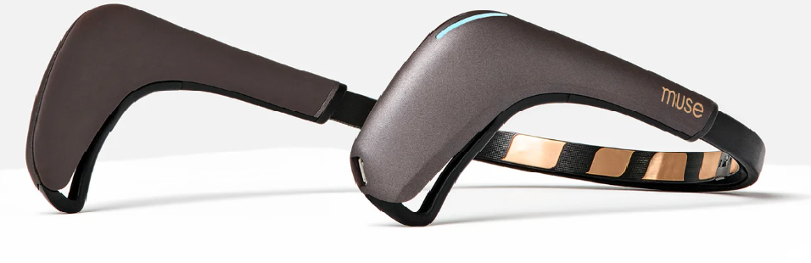
EEG Device (MUSE 2)
The EEG Muse 2 headband is a wearable device that measures and monitors brain activity through EEG sensors placed on the forehead and behind the ears.
It provides real-time feedback and insights into brainwave patterns, allowing users to engage in activities like meditation, brain training, and sleep tracking.
The headband is comfortable, wireless, and has a rechargeable battery, making it convenient for extended use and seamless integration with compatible devices.
Fig: Muse 2 EEG Head Band
11

Slide 12
Sensor Positioning in MUSE 2
Front
Non-Verbal Communication,
Emotion or mood regulation,
Visual processing
Motor controls,
Memory, Concentration,
Problem Solving
AF7
AF8
TP9
TP10
Language Processing
Imagination or Creativity
Back
12

Slide 13
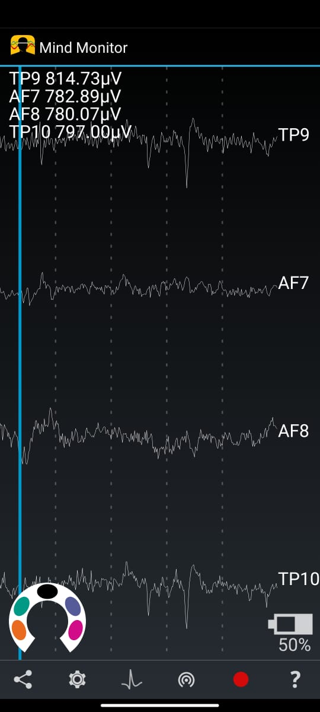
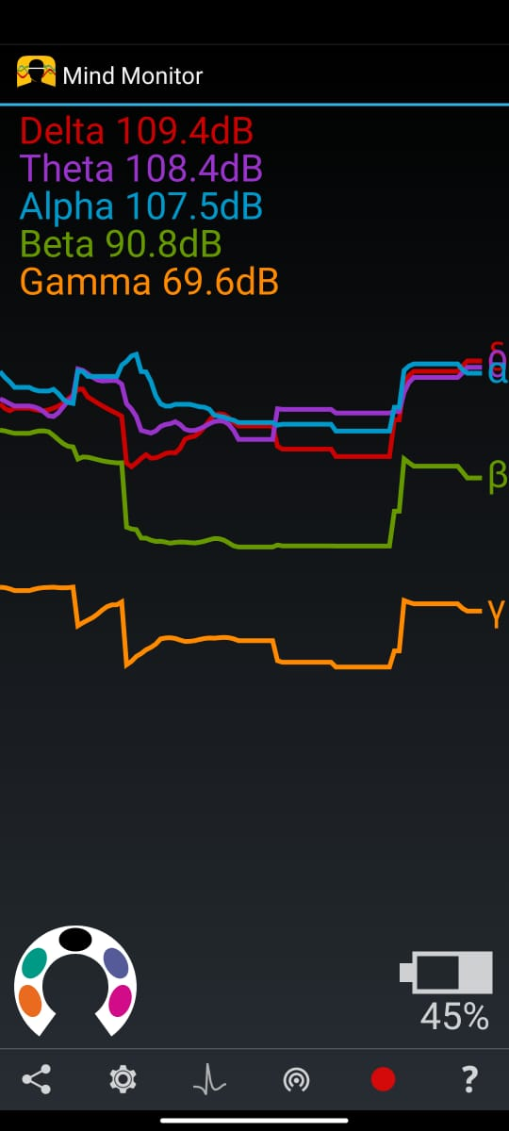
Mind-monitor APK
Mind Monitor is an app that provides neuroscience research students with easy access to EEG data, aiming to advance our understanding of the field and propel mind-controlled technology.
It enables analysis of brain activity, contributing to the development of mind-controlled devices and empowering individuals to overcome physical limitations.
Ultimately, Mind Monitor strives for a future of inclusivity and empowerment through mind-controlled interactions.
13

Slide 14
EEG frequency
Frequency band name | Frequency bandwidth (Hz) | Usual human state associated with bandwidth
Delta | 1–3.9 | Deep sleep
Theta | 4–7.9 | Drowsy, meditate
Alpha | 8–13.9 | Relaxed
Beta | 14–29.9 | Alertness, focused
Gamma | 30–64 | Peak performance
14

Slide 15
EEG Data Preparation
Data Collection
EEG signals collected during the writing Activity

Slide 16
EEG Data Preparation
Data Collection
EDA
EEG signals collected during the writing Activity
Box plot
Histogram
Correlation Heat Map

Slide 17
EEG Data Preparation
Data Collection
Clean (Remove Nan values)
Outlier – (1. first and last 5 secs of data are removed from every CSV file, 2. Mean and Std Deviation)
Partition (train, Test, Validate) – 80:20
Scale (MinMaxScaler(0,1))
EDA
EEG signals collected during the writing Activity
Statistical Analysis
T – test
Box plot
Histogram
Correlation Heat Map
Data
Pre-processing

Slide 18
EEG Data Preparation
Data Collection
Clean (Remove Nan values)
Outlier – (1. first and last 5 secs of data are removed from every CSV file, 2. Mean and Std Deviation)
Partition (train, Test, Validate) – 80:20
Scale (MinMaxScaler(0,1))
EDA
EEG signals collected during the writing Activity
Statistical Analysis
T – test
Box plot
Histogram
Correlation Heat Map
Data
Pre-processing
Feature Engineering
Feature Selection (Absolute EEG features are selected)
Feature Transformation (PCA, ICA,FFT)
Feature Creation (Target Variable- “Dys”)

Slide 19
EEG Data Preparation
Data Collection
Clean (Remove Nan values)
Outlier – (1. first and last 5 secs of data are removed from every CSV file, 2. Mean and Std Deviation)
Partition (Train, Test, Validate) – 80:20
Scale (MinMaxScaler(0,1))
EDA
EEG signals collected during the writing Activity
Statistical Analysis
T – test
Box plot
Histogram
Correlation Heat Map
Data
Pre-processing
Feature Engineering
Feature Selection (Absolute EEG features are selected)
Feature Transformation (PCA, ICA,FFT)
Feature Creation (Target Variable- “Dys”)
ML Models

Slide 20
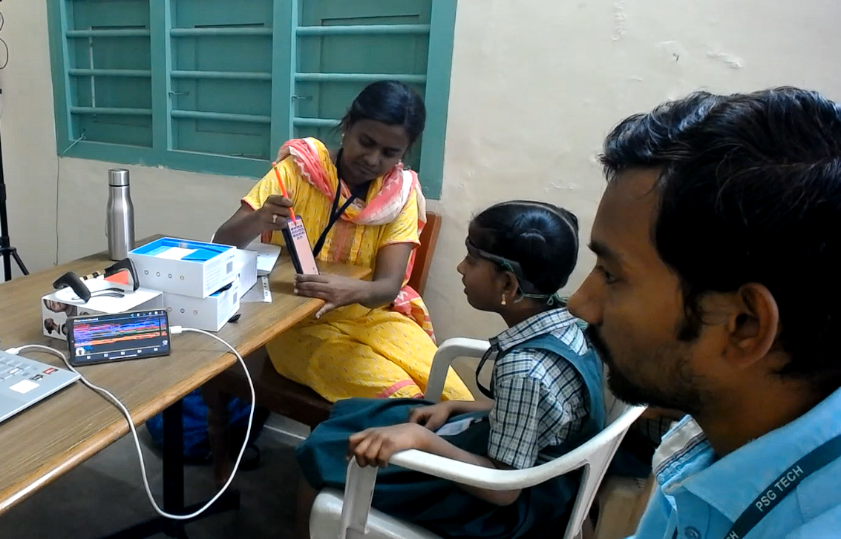
EEG Dataset Collection
PSG Primary School is an educational institution with a student population of 735, comprising 395 male and 340 female students.
Among the student body, 18 were identified with dyslexia.
A comprehensive study was conducted for the age group of 8-9 using the MUSE 2 EEG headband to assess their learning process.
20

Slide 21
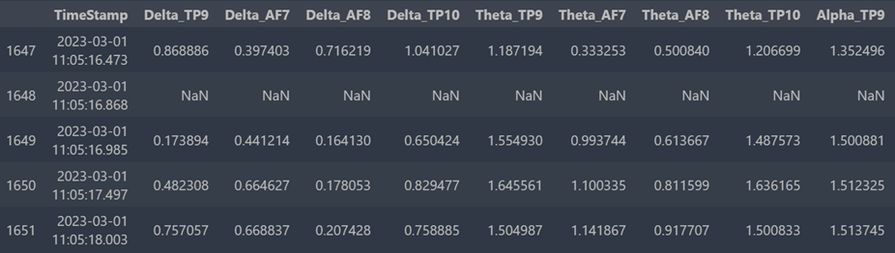
Dataset Details
EEG Dataset
Dataset obtained from dyslexic children - 29 EEG dataset
Normal Children - 28 EEG dataset
Dataset consist of Timestamp, Delta_TP9, Delta_AF7, Delta_AF8, Delta_TP10, Theta_TP9, Theta_AF7, Theta_AF8, Theta_TP10, Alpha_TP9, Alpha_AF7, Alpha_AF8, Alpha_TP10, Beta_TP9, Beta_AF7, Beta_AF8, Beta_TP10, Gamma_TP9, Gamma_AF7, Gamma_AF8, Gamma_TP10, RAW_TP9, RAW_AF7, RAW_AF8, RAW_TP10, AUX_RIGHT, Mellow, Concentration, Accelerometer_X Accelerometer_Y, Accelerometer_Z, Gyro_X, Gyro_Y, Gyro_Z, HeadBandOn, HSI_TP9, HSI_AF7, HSI_AF8, HSI_TP10, Battery, and Elements.
Fig: Sample EEG dataset

Slide 22
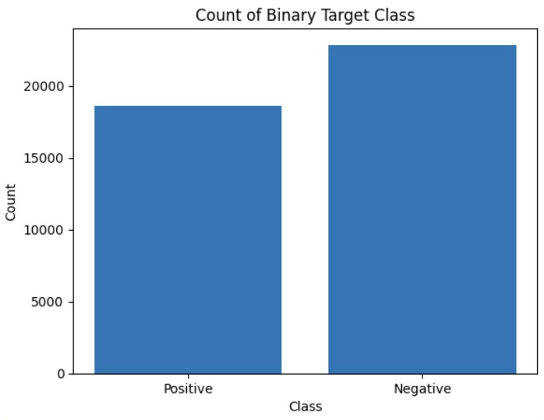
EDA
CSV files
Normal : 28
Dyslexia : 29
Instance in Each Class
Normal (0) - 18637
Dyslexia (1) - 22843

Slide 23
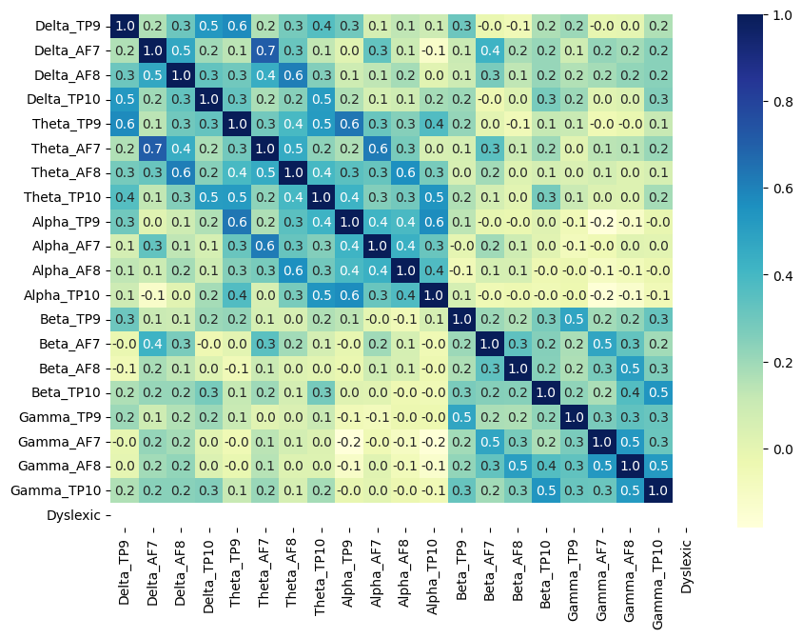
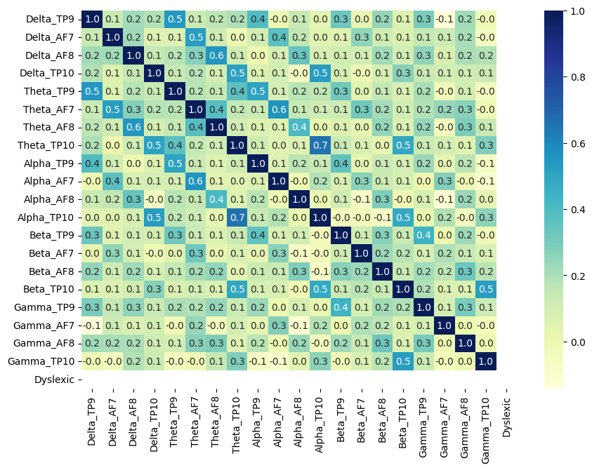
Correlation Matrix Heat Map
Fig: Dyslexic writing EEG
Fig: Non- Dyslexic writing EEG

Slide 24
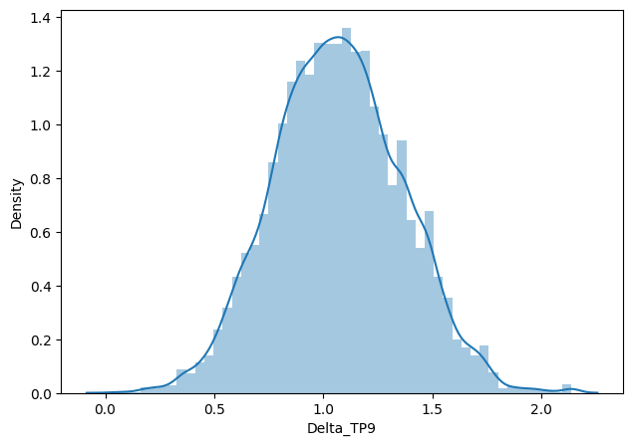
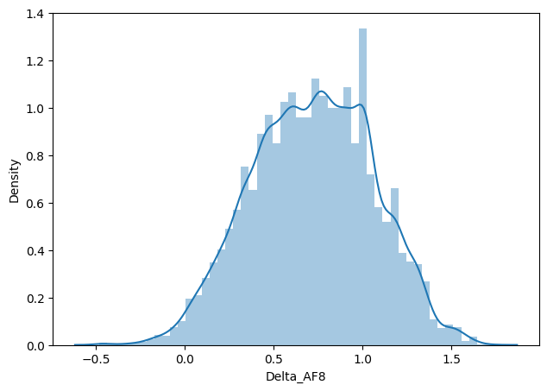
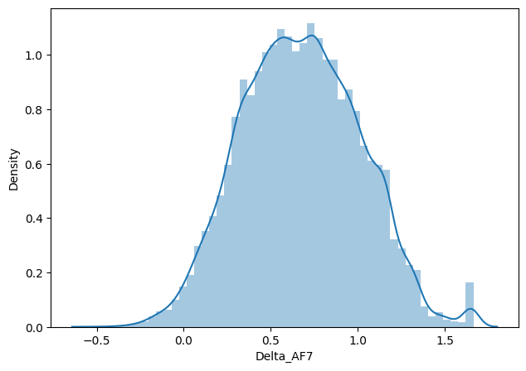
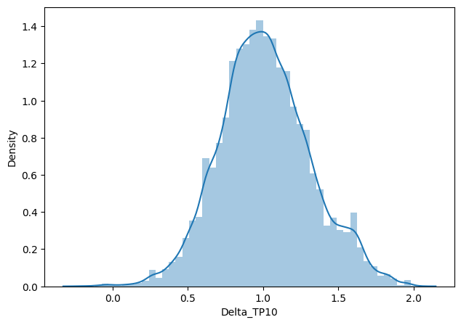
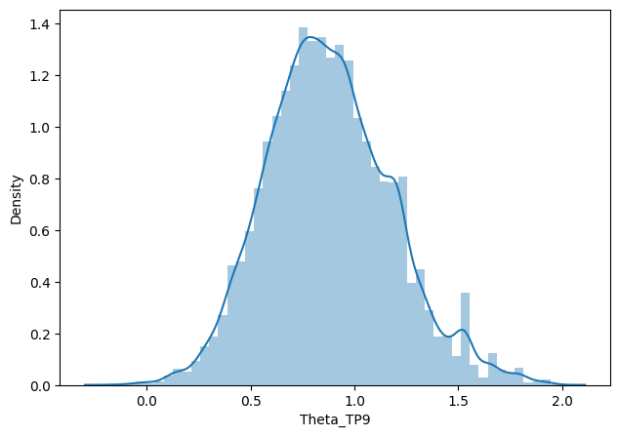
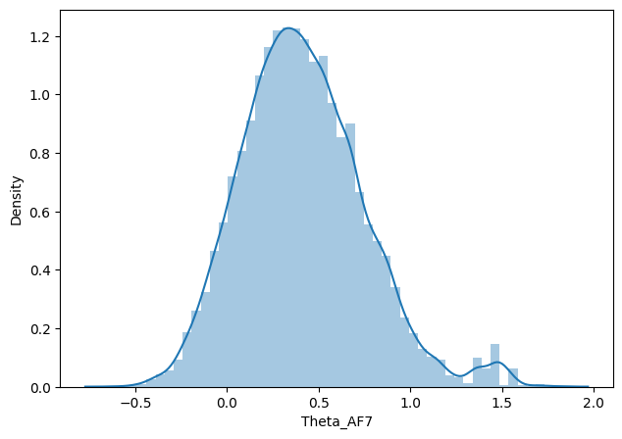
Data Distribution Graphs

Slide 25
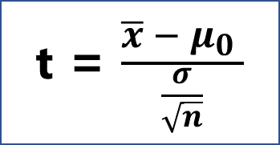
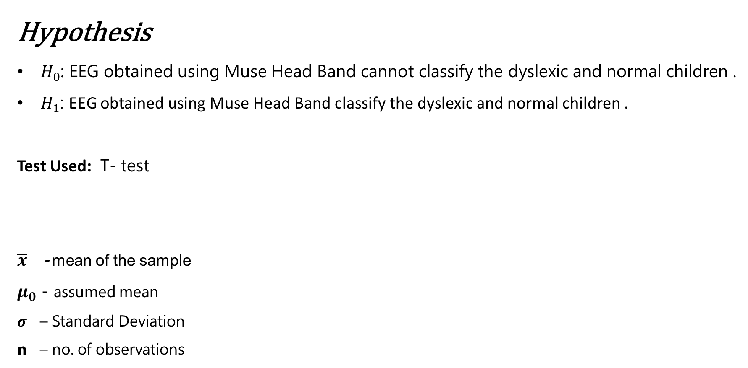
Statistical Analysis
Hypothesis
$H_{0}$: EEG obtained using Muse Head Band cannot classify the dyslexic and normal children .
$H_{1}$: EEG obtained using Muse Head Band classify the dyslexic and normal children .
Test Used: T- test
$\overline{x}$ - mean of the sample
$μ_{0}$ - assumed mean
$σ$ – Standard Deviation
n – no. of observations
t = $\frac{\overline{x} − μ_{0} }{\frac{σ}{\sqrt{n}}}$
25

Slide 26
Hypothesis Testing
*p<0.05 – statistically significant
Signals | Normal | Dyslexia | P-value | Result
Delta_TP9 | 1.11 ± 0.09 | 1.07 ± 0.09 | 1.15637E-38 | Reject null hypothesis, means are significantly different
Delta_AF7 | 0.71 ± 0.10 | 0.67 ± 0.12 | 1.00187E-23 | Reject null hypothesis, means are significantly different
Delta_AF8 | 0.69 ± 0.11 | 0.72 ± 0.12 | 2.09604E-15 | Reject null hypothesis, means are significantly different
Delta_TP10 | 1.06 ± 0.09 | 1.01 ± 0.09 | 1.132E-62 | Reject null hypothesis, means are significantly different
Theta_TP9 | 0.91 ± 0.09 | 0.88 ± 0.09 | 8.43411E-30 | Reject null hypothesis, means are significantly different
Theta_AF7 | 0.45 ± 0.09 | 0.42 ± 0.11 | 2.06391E-31 | Reject null hypothesis, means are significantly different
Theta_AF8 | 0.45 ± 0.11 | 0.44 ± 0.12 | 2.41092E-06 | Reject null hypothesis, means are significantly different
Theta_TP10 | 0.91 ± 0.11 | 0.86 ± 0.10 | 5.25888E-41 | Reject null hypothesis, means are significantly different
Alpha_TP9 | 1.01 ± 0.08 | 0.98 ± 0.08 | 9.99392E-23 | Reject null hypothesis, means are significantly different
Alpha_AF7 | 0.61 ± 0.06 | 0.59 ± 0.08 | 2.1542E-15 | Reject null hypothesis, means are significantly different
Alpha_AF8 | 0.62 ± 0.08 | 0.60 ± 0.08 | 3.16125E-16 | Reject null hypothesis, means are significantly different
Alpha_TP10 | 1.03 ± 0.11 | 0.97 ± 0.08 | 8.5531E-115 | Reject null hypothesis, means are significantly different
Beta_TP9 | 0.73 ± 0.04 | 0.65 ± 0.04 | 0 | Reject null hypothesis, means are significantly different
Beta_AF7 | 0.41 ± 0.05 | 0.26 ± 0.06 | 0 | Reject null hypothesis, means are significantly different
Beta_AF8 | 0.47 ± 0.08 | 0.30 ± 0.09 | 0 | Reject null hypothesis, means are significantly different
Beta_TP10 | 0.83 ± 0.05 | 0.75 ± 0.05 | 1.9549E-272 | Reject null hypothesis, means are significantly different
Gamma_TP9 | 0.22 ± 0.05 | 0.16 ± 0.05 | 1.4592E-124 | Reject null hypothesis, means are significantly different
Gamma_AF7 | -0.13 ± 0.06 | -0.19 ± 0.09 | 3.736E-109 | Reject null hypothesis, means are significantly different
Gamma_AF8 | -0.04 ± 0.12 | -0.19 ± 0.13 | 0 | Reject null hypothesis, means are significantly different
Gamma_TP10 | 0.35 ± 0.05 | 0.36 ± 0.06 | 0.001819675 | Reject null hypothesis, means are significantly different
26

Slide 27
Feature Engineering
Extracting the relevant and informative features from the data that can capture the underlying relation and patterns.
Scaling and normalization are used to standardize the data and bring all the feature similar scale.
Feature extraction involves creating new features from the existing features or using statistical methods such PCA, ICA and FFT.
27

Slide 28
EEG Classification model
EEG signals
EEG csv
Pre-processing
Feature Engineering
Feature Selection
Classifier
Output
28

Slide 29
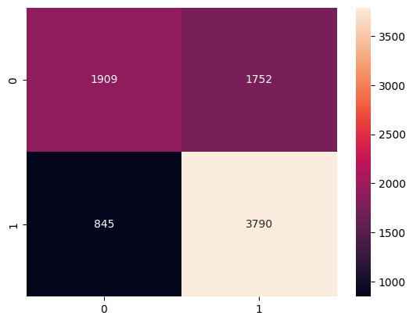
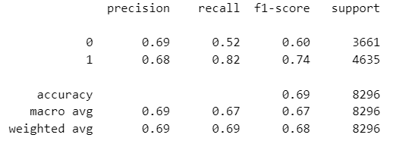
Linear SVM
Fig: Linear SVM Classification Report (left) and Confusion Matrix (Right)

Slide 30
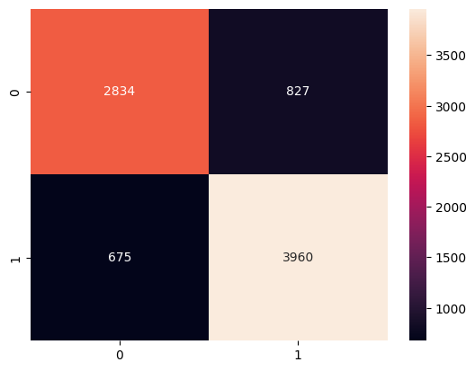
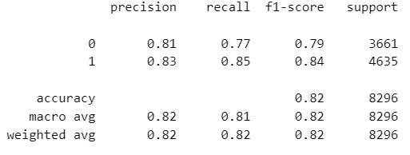
Non- Linear SVM
Fig: Non- Linear SVM Classification Report (left) and Confusion Matrix (Right)

Slide 31
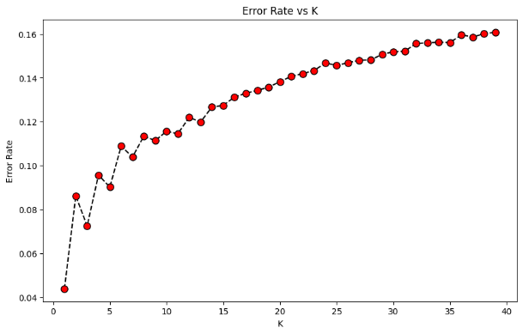
K-Nearest Neighbour (KNN) Classifier
Fig: K-value vs Error Rate

Slide 32
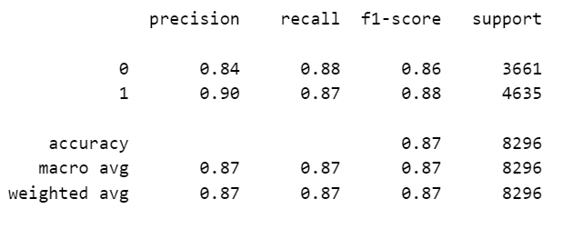
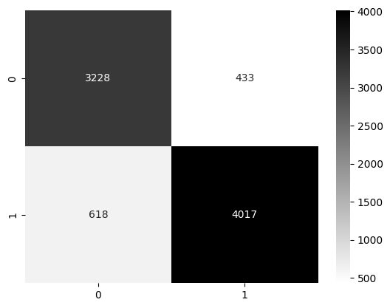
K – Nearest Neighbour (KNN)
Fig: KNN Classification Report (left) and Confusion Matrix (Right)
K Value Selected for KNN classifier: 14

Slide 33
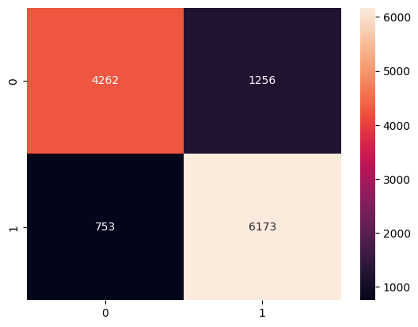
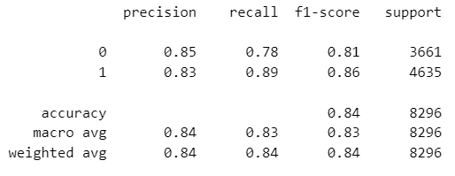
Random Forest(RF) Classifier
GridSearchCV used for searching the hyper parameters.
Best hyperparameters: {'max_depth': 10, 'min_samples_leaf': 2, 'min_samples_split': 3}
Fig: RF Report (left) and Confusion Matrix (Right)

Slide 34
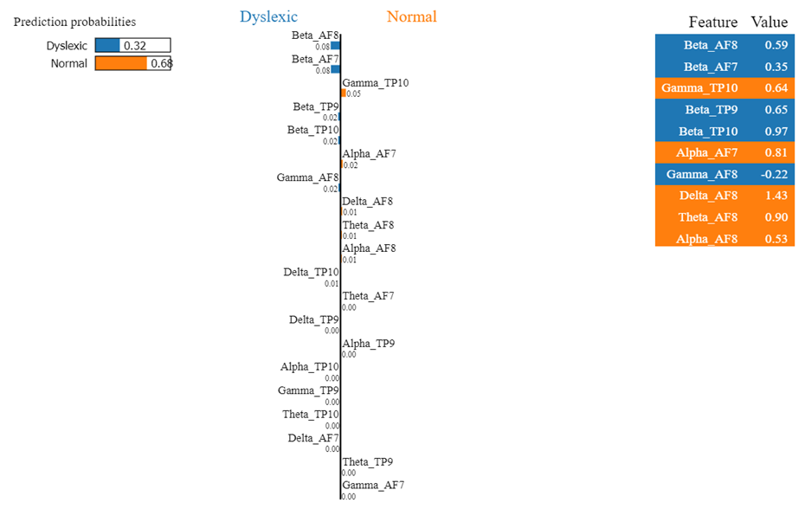
Explainable AI (XAI) – LIME (RF Model)
34

Slide 35
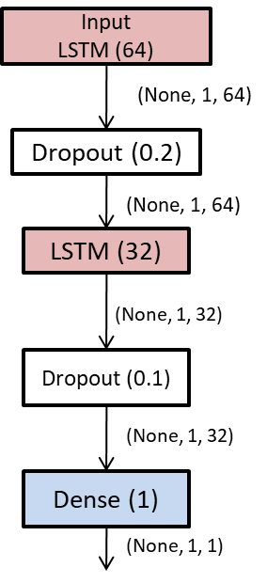
LSTM – Long Short Term Memory
CSV file 2D dataset
Converting it to 3D dataset by adding Time Steps =1
Loss: Binary Cross Entropy
Activation Function: Sigmoid
Optimizer: Adam
Accuracy : 82%
Loss : 0.1181
35

Slide 36
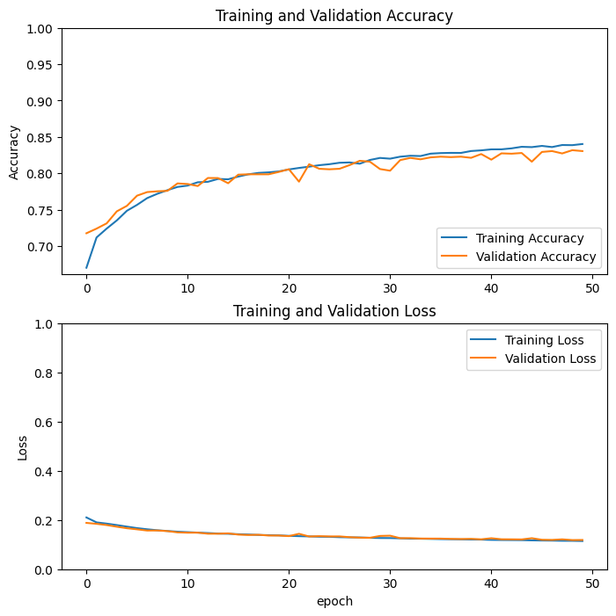
LSTM Performance
36

Slide 37
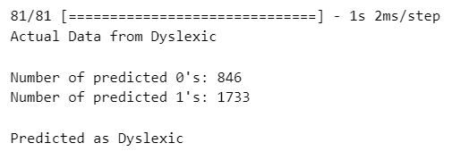
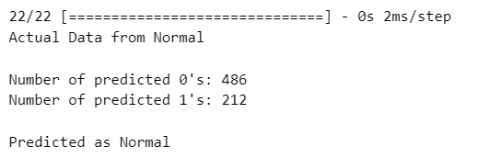
Testing LSTM Model
Fig: Dyslexic dataset Prediction
Fig: Normal dataset Prediction
37

Slide 38
Classifier Results Comparision
38

Slide 39
Handwritten Characters Dataset
Image Dataset
At present Total No. of Image dataset collected from Children – 25,000 images.(25 letters)
Dyslexic Handwritten Image dataset consist of 10,000 images
Normal Handwritten Image dataset consist of 15,000 images
Total No. of Image dataset collected from Children – 25,000 images.( letters)
Dyslexic Handwritten Image dataset consist of 10,000 images
Normal Handwritten Image dataset consist of 15,000 images
39

Slide 40
Image Pre-processing
Tamil Handwritten Alphabets collected from the dyslexic and non-dyslexic children.
Segmentation algorithm is used to extract the image.
RGB image is converted in to Grayscale image
Data Augmentation:
Since the no. of image collected from the dyslexic children are less Data Augmentation Technique is used.
Parameters used are:
Horizontal Flip
Vertical Flip
Rotation

Slide 41
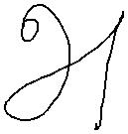
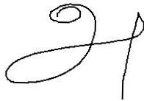
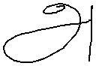

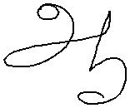
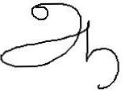
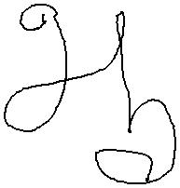
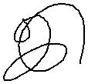
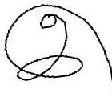
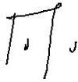
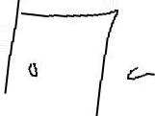


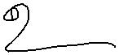
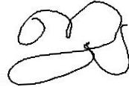

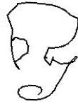


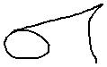
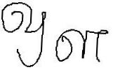
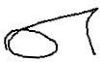
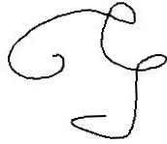
Normal Writings

Slide 42
















Dyslexic Writings

Slide 43
Image Classification Model
CNN model
Image Preprocessing
Classifier
Output
Input Image

Slide 44
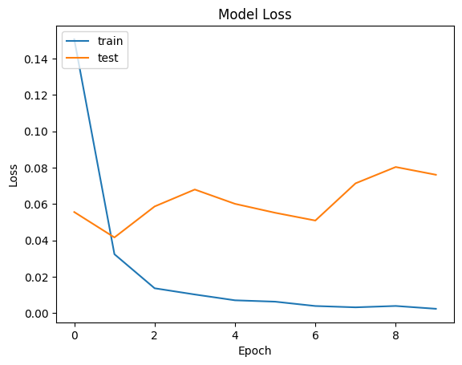
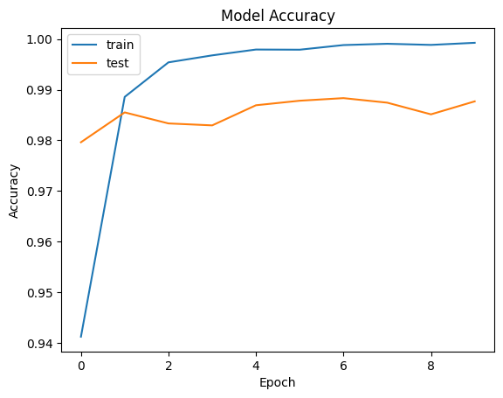
CNN model 1 Results
Fig: Model 1 Accuracy Graph
Fig: Model 1 Loss Graph

Slide 45
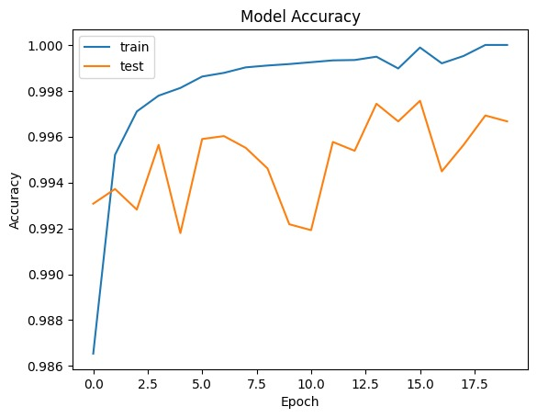

CNN model 2 Results
Fig: Model 2 Accuracy Graph
Fig: Model 2 Loss Graph

Slide 46

CNN model 3 Architecture
Loss Function : Binary Cross Entropy
Activation Function: Sigmoid
Optimizer: Adam
Accuracy: 99.6%
Loss : 0.013
46

Slide 47


CNN model 3 Results
Fig: Model 3 Accuracy Graph
Fig: Model 3 Loss Graph

Slide 48
CNN model Hyper Parameters
Hyper Parameters | CNN Model 1 | CNN model 2 | CNN model 3
Shape of Image | (100,100,3) | (100,100,1) | (100,100,1)
Conv2d | 2 | 3 | 4
Maxpooling | 2 | 3 | 2
Flatten | 1 | 1 | 1
Dense | 2 | 2 | 2
Dropout | 0 | 0 | 3
Activation Function | ReLU | ReLU | ReLU
Loss Function | Binary Cross Entropy | Binary Cross Entropy | Binary Cross Entropy
Activation function at Output Layer | Sigmoid | Sigmoid | Sigmoid
Learning Rate | 0.001 | 0.001 | 0.001
Optimizer | Adam | Adam | Adam
Epochs | 20 | 20 | 20
Loss | 0.03 | 0.004 | 0.013
Accuracy | 98.7% | 99.4% | 99.6
Time taken to Train Model | 71m 38.5s | 79m 15.5s | 4hrs 52m 31.1s
Conclusion | Underfit | Underfit | Good Fit

Slide 49


Testing CNN model
49

Slide 50
Software Tools Required
APK : Mind monitor APK
EEG Device : Muse 2 Headband
Programming Language : Python 3.10 or above
Libraries or Packages : Pandas, NumPy, Scikit-learn, Matplotlib, TensorFlow, and Keras
IDE : Visual Studio Code (Jupyter Note Book)
50

Slide 51
System Requirements
Operating System : Windows 10
RAM : 16 GB RAM
CPU : Intel Xenon
GPU : NIVIDA RTX 2000A
Core(s) : 8 Core(s) 12 logical processors
ROM : 500 GB
51

Slide 52
Multimodal Fusion
Feature Level Fusion – Contact the Feature in the dataset to get the result
Limitation:
Two dataset Should have equal no. of Instance.
Two Dataset Collected should not be collected separately.
Decision Level Fusion – Using the result of the models and fusing them to get Results.
Average Fusion
Concat using Dense Layer
Weighted Sum Fusion
52

Slide 53
Proposed Multimodal Architecture
CNN model
Image Preprocessing
Concat (CNN, NN)
Outputs
Fusion Method()
Output
Input Image
EEG csv
Pre-processing
LSTM
Feature Engineering
Feature Selection
EEG signals

Slide 54


Concatenation Fusion Method
Loss function: 'binary_crossentropy’
Optimizer: 'adam’
Epoch : 50
Accuracy : 50.15%
Loss : 0.2251
54

Slide 55


Multimodal Average fusion Performance
Loss function: 'binary_crossentropy’
Optimizer: 'adam’
Epoch : 50
Accuracy : 99.5%
Loss : 0.2451
55

Slide 56




Testing Average Fusion model
Fig: Correct prediction of Average Multimodal (Left & Right)
Fig: Partially correct prediction (Left) and Wrong Prediction (Right)
56

Slide 57
Conclusion
Multimodal deep learning enables accurate assessment of dyslexic children's learning abilities by combining brain signal, behavioral observations, and performance measures.
SVM and RF classifiers yield 70% and 83% accuracy, while LSTM and CNN-III models achieve 82% and 99% accuracy, respectively.
The average multimodal model achieves 99% accuracy. Future research can explore additional modalities, such as eye-tracking and socio-emotional data, for a comprehensive understanding of dyslexia.

Slide 58
References
B. Peixoto, B. Lavi, P. Bestagini, Z. Dias and A. Rocha, "Multimodal Violence Detection in Videos," ICASSP 2020 - 2020 IEEE International Conference on Acoustics, Speech and Signal Processing (ICASSP), Barcelona, Spain, 2020, pp. 2957-2961, doi: 10.1109/ICASSP40776.2020.9054018.
Y. Zhou, J. Du, K. Guan and T. Wang, "Multi-modal Broad Learning System for Medical Image and Text-based Classification," 2021 43rd Annual International Conference of the IEEE Engineering in Medicine & Biology Society (EMBC), Mexico, 2021, pp. 3439-3442, doi: 10.1109/EMBC46164.2021.9630854.
J. H. Moon, H. Lee, W. Shin, Y. -H. Kim and E. Choi, "Multi-Modal Understanding and Generation for Medical Images and Text via Vision-Language Pre-Training," in IEEE Journal of Biomedical and Health Informatics, vol. 26, no. 12, pp. 6070-6080, Dec. 2022, doi: 10.1109/JBHI.2022.3207502.
M. Krecichwost, A. Sage, Z. Miodonska and P. Badura, "4D Multimodal Speaker Model for Remote Speech Diagnosis," in IEEE Access, vol. 10, pp. 93187-93202, 2022, doi: 10.1109/ACCESS.2022.3203572.
J. Zhu et al., "Multimodal Mild Depression Recognition Based on EEG-EM Synchronization Acquisition Network," in IEEE Access, vol. 7, pp. 28196-28210, 2019, doi: 10.1109/ACCESS.2019.2901950.
58

Slide 59
References
Singh A, Ranjbarzadeh R, Raj K, Kumar T, Roy AM. Understanding EEG signals for subject-wise Definition of Armoni Activities. arXiv preprint arXiv:2301.00948. 2023 Jan 3.
M. A. Abdullah and L. R. Christensen, "EEG Emotion Detection Using Multi-Model Classification," 2018 International Conference on Bioinformatics and Systems Biology (BSB), Allahabad, India, 2018, pp. 178-182, doi: 10.1109/BSB.2018.8770695.
Syed Umar Amin, Mansour Alsulaiman, Ghulam Muhammad, Mohamed Amine Mekhtiche, M. Shamim Hossain, “Deep Learning for EEG motor imagery classification based on multi-layer CNNs feature fusion” Future Generation Computer Systems, Volume 101, 2019, Pages 542-554, ISSN 0167-739X, https://doi.org/10.1016/j.future.2019.06.027.
N. S. Karuppusamy and B. -Y. Kang, "Multimodal System to Detect Driver Fatigue Using EEG, Gyroscope, and Image Processing," in IEEE Access, vol. 8, pp. 129645-129667, 2020, doi: 10.1109/ACCESS.2020.3009226.
Debashis Das Chakladar, Pradeep Kumar, Partha Pratim Roy, Debi Prosad Dogra, Erik Scheme, Victor Chang, A multimodal-Siamese Neural Network (mSNN) for person verification using signatures and EEG, Information Fusion, Volume 71, 2021, Pages 17-27, ISSN 1566-2535, https://doi.org/10.1016/j.inffus.2021.01.004
59

Slide 60
References
Perera, H., Shiratuddin, M.F. & Wong, K.W. Review of EEG-based pattern classification frameworks for dyslexia. Brain Inf. 5, 4 (2018). https://doi.org/10.1186/s40708-018-0079-9
Zhang B, Chai C, Yin Z, Shi Y. Design and Implementation of an EEG-Based Learning-Style Recognition Mechanism. Brain Sciences. 2021; 11(5):613. https://doi.org/10.3390/brainsci11050613
60

Slide 61
Thank You
61

